Slide 1
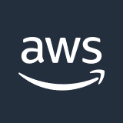




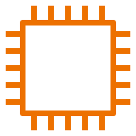

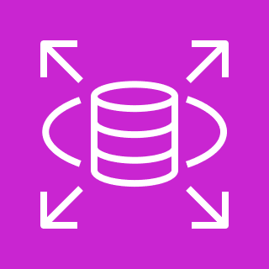
AWS Cloud
VPC
Internet gateway
Public subnet
NAT gateway
Web Instance
Private subnet
Application
Instance
RDS

